Slide 1
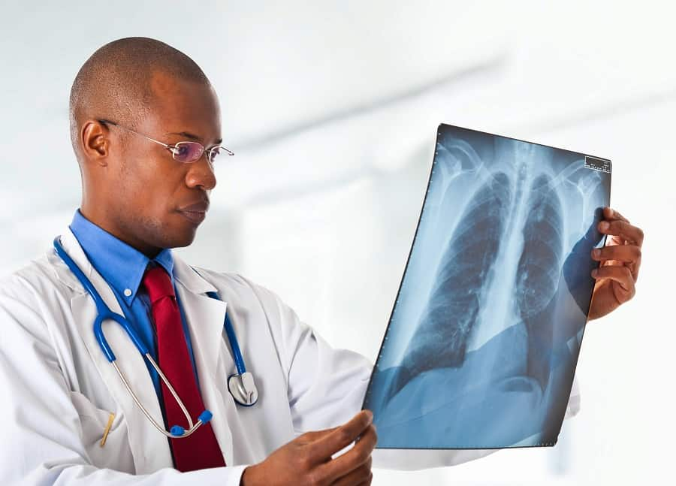
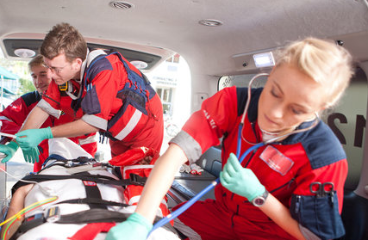
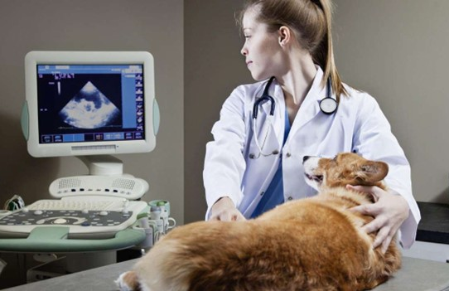

Slide 2
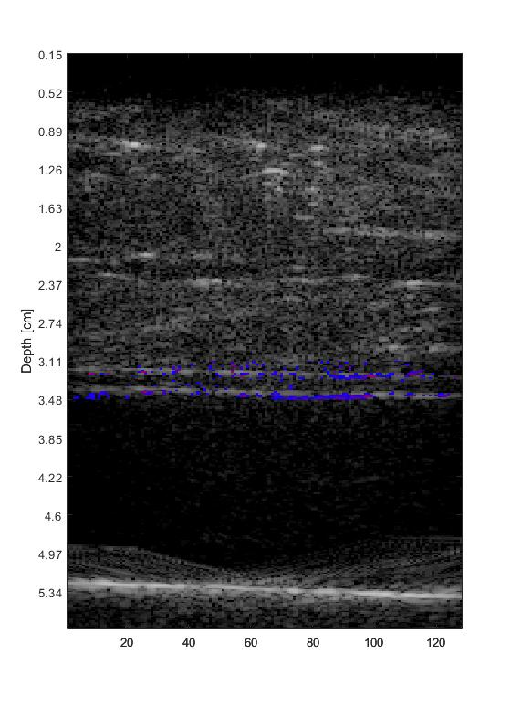
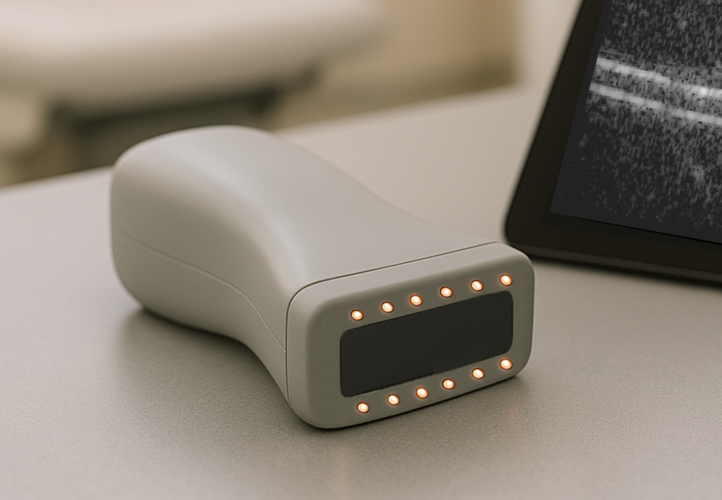
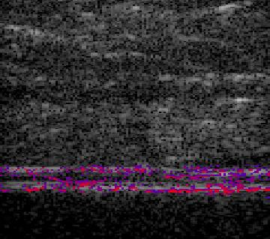
sPO₂ = 5%
Tube carrying blood
sPO₂ = 95%
*Final version may vary from image

Slide 3



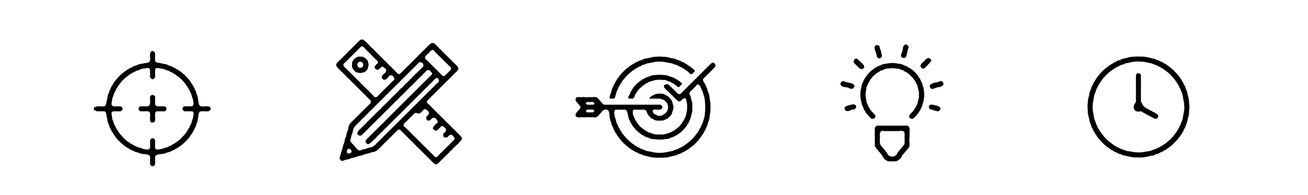

Slide 4
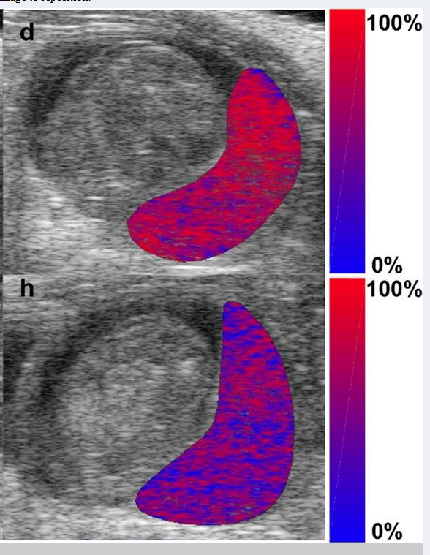
Normal Placenta
Hypertensive Placenta
Lawrence et. al. (2019) “Spectral photoacoustic imaging to estimate in vivo placental oxygenation during preeclampsia” Scientific Reports
background-size: 145% !important;
background-position: center !important;
background-repeat: no-repeat !important;

Slide 5
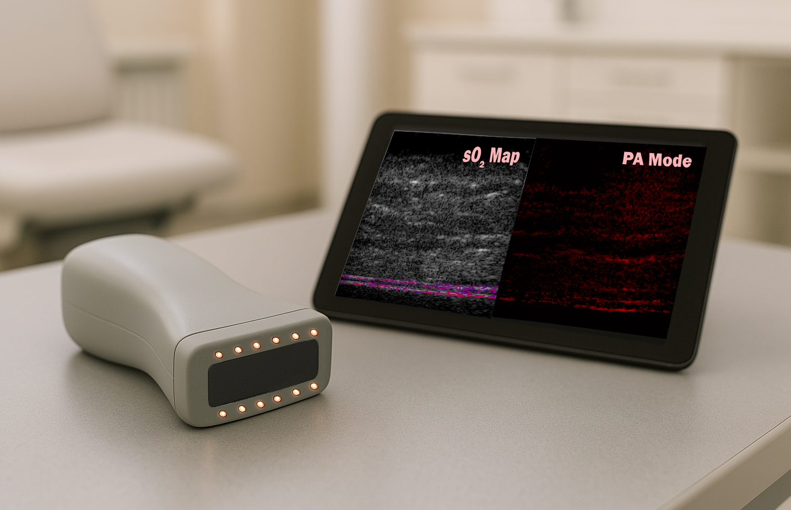

Slide 6
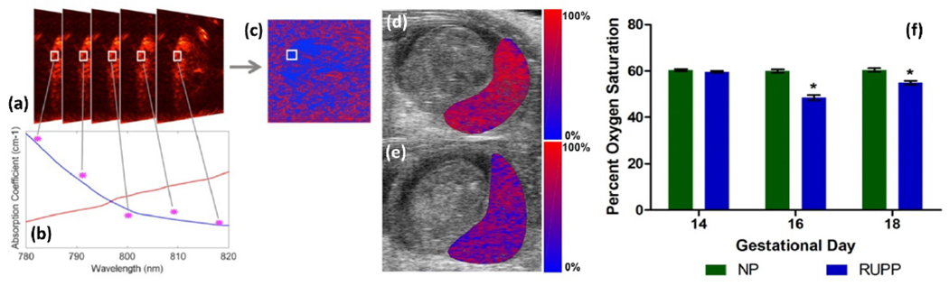
Normal Placenta
100%
Oxygenation (%)
Hypertensive Placenta
Deoxy-Hb
Oxy-Hb
0%

Slide 7
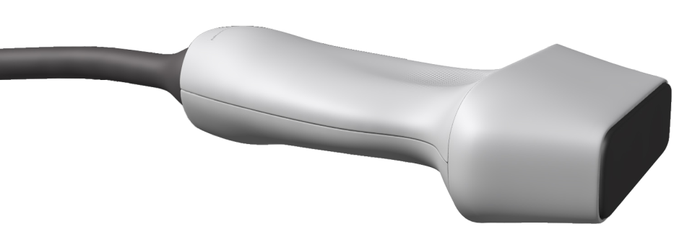
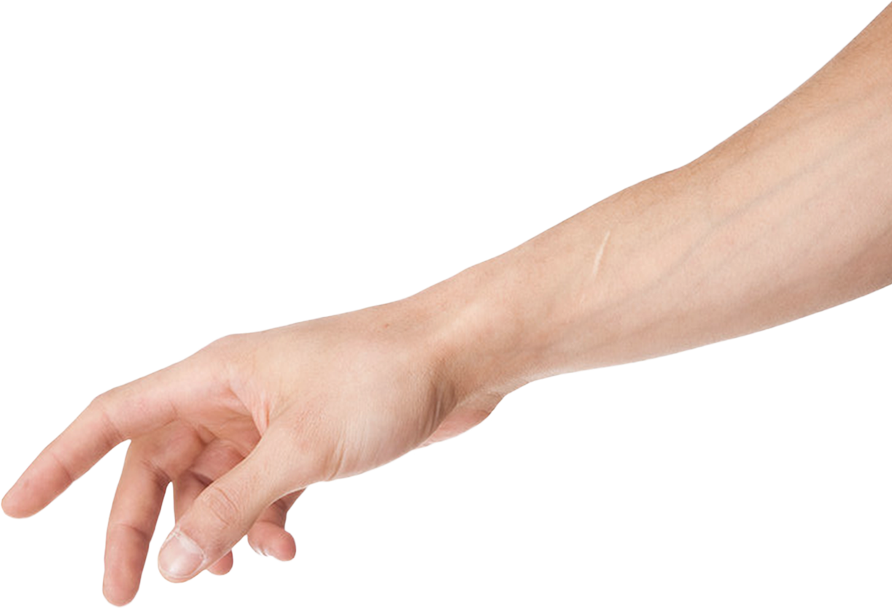
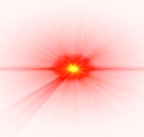
Transducer
Sound Waves
Nanosecond Laser Pulse

